Slide 1
What STAFF need to KNOW about Diabetes!
Develop a TEAM approach
Empower your team with knowledge
Insulin injections
Provide quick start guides to staff for symptoms
Provide quick start guides for residents who have diabetes; talk about these residents with staff, so they know what to expect and what to look for.
Role play to ready staff for crises with residents.
Teach staff how to encourage positive/healthy behaviors.
This Photo by Unknown Author is licensed under CC BY

Slide 2
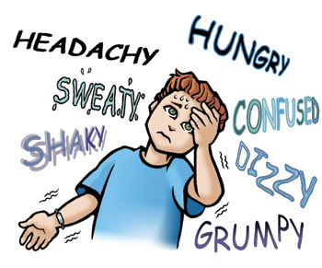
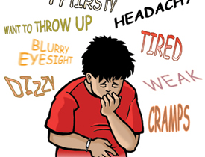
HYPO/HYPERGLYCEMIA – Teach the symptoms
ROLE PLAY can help staff respond appropriately
This Photo by Unknown Author is licensed under CC BY
This Photo by Unknown Author is licensed under CC BY-SA

Slide 3
Do all diabetic residents have working glucometers?
Check monthly to ensure glucometers are working correctly.
Easy to add to monthly medication checks when residents are self-med.
Make a plan for crisis for each resident. Decide on a place to keep it to ensure it’s handy for ALL staff to access.
Decide as a team what the response will be and add it as an addendum to the service plan.
Have a “Diabetic of the month” resident to discuss at inservices to keep the level of awareness high.
Incentivize staff who are able to state the plan for residents.

Slide 4
Skin and Feet: The “Achilles Heel” for diabetics
Teach staff how to carefull look at all skin when they are assisting with personal care.
Foot checks should be part of daily routine as residents don shoes.

Slide 5
Help Residents Help Staff
Group training has evidence support success
Teach residents how to report high/low blood sugar symptoms
Adherence to diet
Report skin issues
Pay attention to feet/footwear
Exercise clubs
In house vision screening
Blood pressure checks

Slide 6
Insulin
Pre-planning is everything
Review blood sugar logs prior to admission
Individualized care is important; resident habits are critical
Involve others in training. Pharmacy and home health partners can help. Take advantage of new initiatives to train staff.

