Slide 1
Leveraging the Power of Emotional Intelligence
Presented By:
Jen Shirkani

Slide 2
Most often, success or failure
in a job comes down to how
we manage ourselves and
how well we manage
relationships with
others…
…not how much we know.

Slide 3
EMOTIONAL INTELLIGENCE (EQ)

Slide 4
EQ Can Be Measured

Slide 5
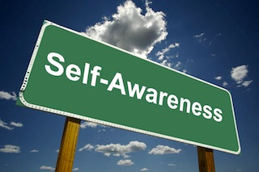
Recognize

Slide 6
EQ SELF-ASSESSMENT
When someone makes comments to me about how to improve, I:
A. Ask for more details so that I can thoroughly understand their feedback.
B. Show appreciation for being candid with me about how I’m doing.
C. Weigh it against the feedback I’ve received in the past to see whether or not it aligns.

Slide 7
EQ SELF-ASSESSMENT
When someone makes comments to me about how to improve, I:
C. Weigh it against the feedback I’ve received in the past to see whether or not it aligns.
B. Show appreciation for being candid with me about how I’m doing.
A. Ask for more details so that I can thoroughly understand their feedback.

Slide 8
SUCCESS REQUIRES THE CONSCIOUS ALIGNMENT OF YOUR SELF-PERCEPTION TO THE PERCEPTIONS OF THOSE AROUND YOU.

Slide 9
Read

Slide 10
EQ SELF-ASSESSMENT
When I am trying to understand the way other people feel:
A. I put myself in their shoes until I agree with their perspective.
B. I go with my gut; I can read others quickly based on my experience.
C. I seek clues to interpret their preferred communication style.

Slide 11
EQ SELF-ASSESSMENT
When I am trying to understand the way other people feel:
B. I go with my gut; I can read others quickly based on my experience.
A. I put myself in their shoes until I agree with their perspective.
C. I seek clues to interpret their preferred communication style.

Slide 12
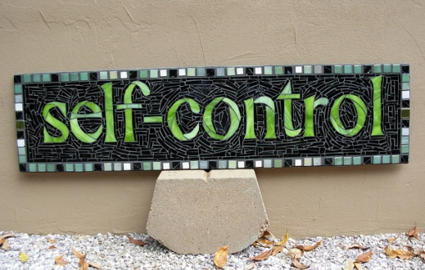
Respond

Slide 13
EQ SELF-ASSESSMENT
When others around me are agitated or upset:
A. I match their level of emotional intensity, verbally and non-verbally.
B. I always stay calm and collected.
C. I have a hard time controlling my reactions when someone is challenging me.

Slide 14
EQ SELF-ASSESSMENT
When others around me are agitated or upset:
C. I have a hard time controlling my reactions when someone is challenging me.
B. I always stay calm and collected.
A. I match their level of emotional intensity, verbally and non-verbally.

Slide 15
Pair & Share Discussion
How does using EQ increase quality of
resident care?

Slide 16
Flexibility

Slide 17
EQ SELF-ASSESSMENT
When faced with an unexpected change:
I make it a point to not overreact and keep the status quo until otherwise notified.
I lose focus on other things until I can regain control.
I can adapt quickly, I don’t lose productivity or effectiveness.

Slide 18
EQ SELF-ASSESSMENT
When faced with an unexpected change:
I make it a point to not overreact and keep the status quo until otherwise notified.
I lose focus on other things until I can regain control.
I can adapt quickly, I don’t lose productivity or effectiveness.

Slide 19
Flexibility and Managing Change Style
Conserver:
Prefers Known to Unknown
Pragmatist:
Prefers to explore the current situation objectively
Originator:
Prefers a faster spontaneous approach to change
Notes:
Conserver: Prefers the known to the unknown. Disciplined, Detailed, Deliberate and Organized.
Pragmatist: Prefers to explore the current situation in an objective manner. Reasonable, Practical, Agreeable & Flexible.
Originator: Prefers a faster and more radical approach to change. Unconventional, Spontaneous, Risk-Takers.
. Explore the advantages, strengths, and liabilities that each style offers on a team.
. Realize the value of all perspectives when resolving issues.
. Understand the preferred work environments for all three change styles.

Slide 20
Optimism

Slide 21
EQ SELF-ASSESSMENT
When I am faced with a setback:
A. It takes me a while to recover.
B. I keep pursuing what I want and believe the future will be better than the past.
C. I am more cautious next time and plan for things to go wrong.

Slide 22
EQ SELF-ASSESSMENT
When I am faced with a setback:
C. I am more cautious next time and plan for things to go wrong.
A. It takes me a while to recover.
B. I keep pursuing what I want and believe the future will be better than the past.

Slide 23
Optimism and Aging
Researchers followed 660 residents for 22 years as part of the Ohio Longitudinal Study of Aging and Retirement
Those with positive attitudes toward aging lived 7 ½ years longer than those with negative views
The study factored out age, gender, socioeconomic status, loneliness and level of physical functioning
Source: Journal of Personality and Social Psychology

Slide 24
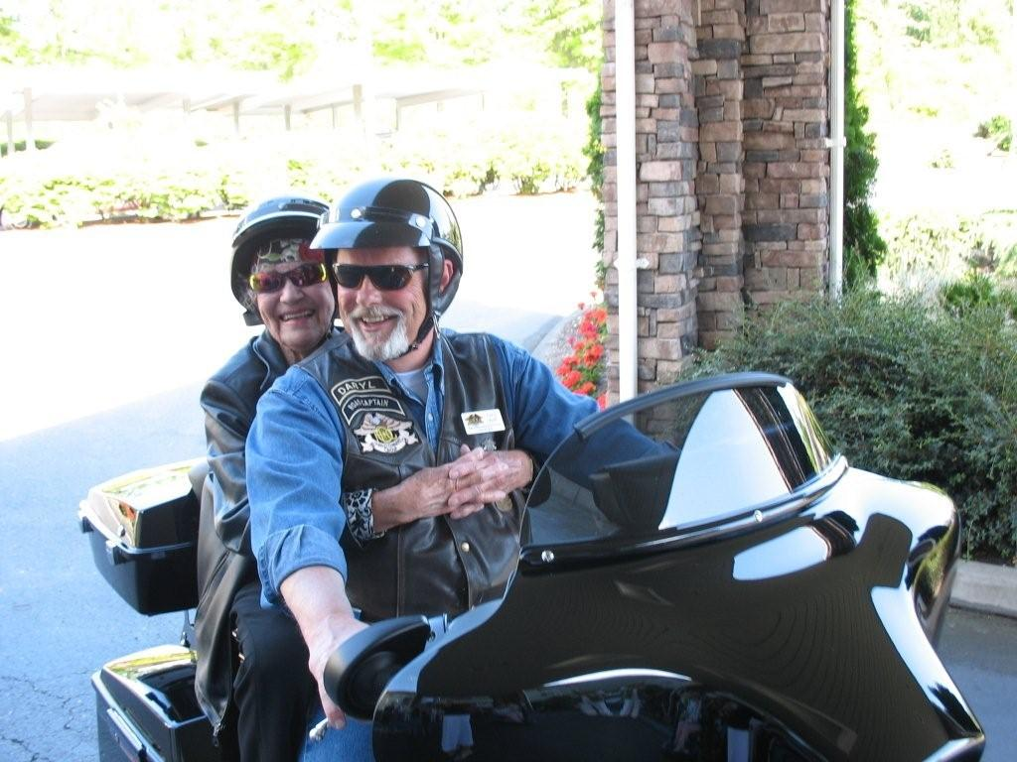
Notes:
Wilma on her 100th birthday

Slide 25
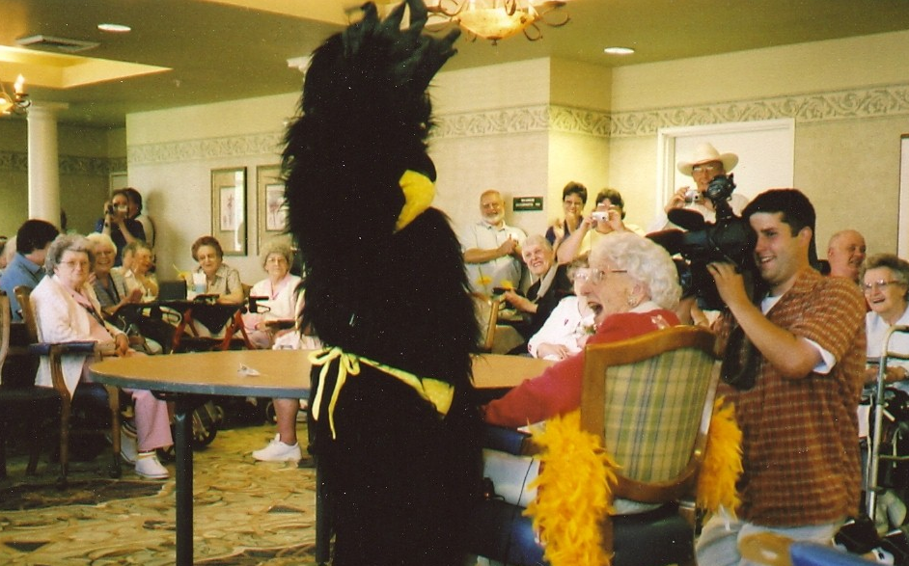
Notes:
Edith 103rd birthday

Slide 26
Questions?

Slide 27
Free Resources:
Free Performance Pointers Articles
Text “Monthly” to 228-28

Slide 28
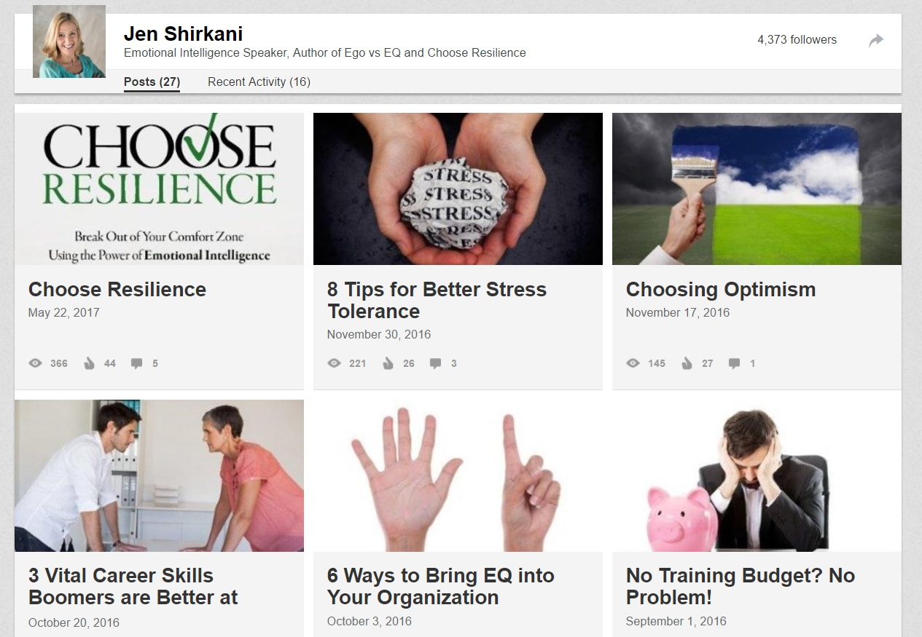
Connect with Me:
www.linkedin.com/in/jenshirkani

