Slide 1
Through the Dementia Caregiver’s Looking Glass:
Training & Retaining a 5 Star Memory Care Team
Schekesia Meadough, BSN, RN, CDP-VP of Health and Wellness

Slide 2
OBJECTIVES/TOPICS
Assisted Living versus Memory Care: how are the challenges similar and dissimilar for those that provide care for dementia and Alzheimer’s residents?
How do we communicate with those with Alzheimer’s?
What are ways we can teach caregivers about what happens to the brain and body in people with dementia?
What are strategies to help caregivers deal with challenging dementia behaviors such as combativeness, agitation, and exit seeking?
What are some useful tips to decrease dementia caregiver burnout?
Ways to retain the dementia caregiver and decrease your turnover rate.

Slide 3

Seniors living with Alzheimer’s/Dementia
The U.S. Census Bureau projects that by 2020, there will be a senior population of 56 million and by 2030, that number will balloon to 74 million seniors.
AD affects 5.5 million Americans age 65 and older today - 380,000 of those individuals are Texans.
Source: Alzheimer’s Disease Facts and Figures 2018 Last updated December 17, 2018

Slide 4
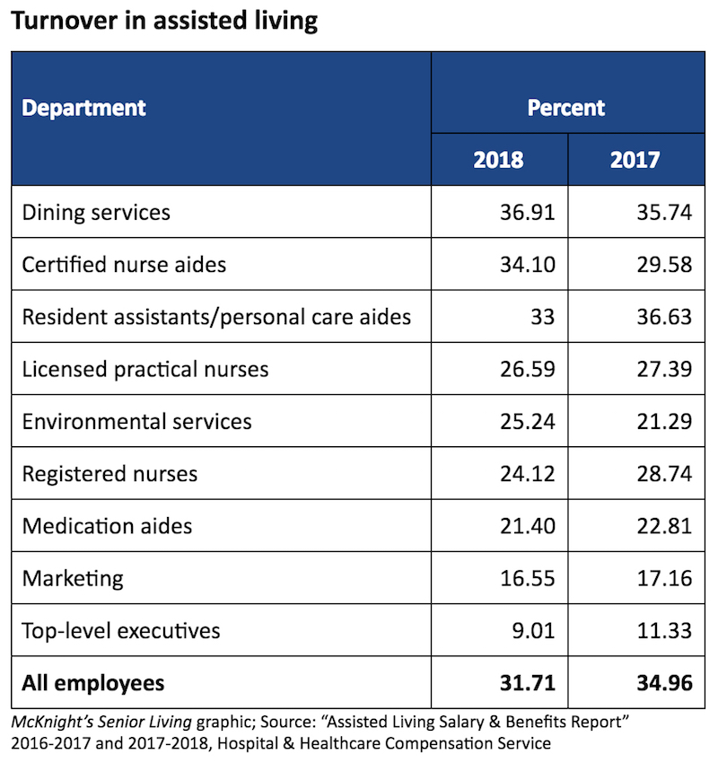
Caregiver Turnover Rates

Slide 5

Cost of Turnover Rates
The Cost of Turnover in the Caregiving Industry
Labor gaps and high turnover rates are bottom line killers for any organization.
Industry analysts estimate that replacing one skilled employee can cost a facility $2500 or more in recruiting and training costs which can be broken into segments such as the following:
Pre-departure disengagement
Recruiting to fill a position
Selection for new hire
Orientation and training
Productivity loss for all staff

Slide 6

FACT or FICTION:
Anyone with senior living work experience is equipped to serve those with Alzheimer’s/dementia?
Notes:
Fiction:

Slide 7
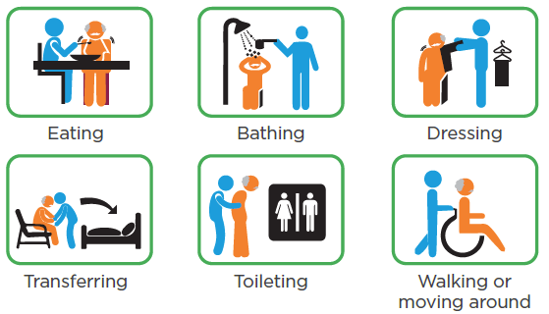
FICTION
Caring for individuals with Alzheimer’s/dementia is complex and challenging. They can be one of the most difficult groups to serve.
It is essential to provide caregivers the tools and training they need to be successful in caring for those living with Alzheimer’s/dementia.

Slide 8

CAREGIVERS ARE
THE HEART OF EVERY COMMUNITY

Slide 9
TEXAS HHS
Texas Health and Human Services licenses assisted living facilities based on residents' physical and mental ability to evacuate the facility in an emergency and whether nighttime attendance is necessary.
A Type A facility cares for residents who do not require routine attendance during sleeping hours and are capable of following directions in an emergency.
A Type B facility is for residents who require staff assistance to evacuate, are not capable of following directions in an emergency and require nighttime attendance (may be an Assisted Living with Alzheimer’s certification).
Assisted living facilities are regulated under Health and Safety Code, Chapter 247 and Texas Administrative Code(TAC), Title 40, Part I, Chapter 92.
Notes:
These can be assisted living with a dementia unit or free standing memory care.

Slide 10
Texas Training Requirement for Type B
Assisted Living Facility with a Dementia Unit or
Free Standing Memory Care
(a) A facility must adopt, implement, and enforce a written policy that:
(1) requires a facility employee who provides direct care to a resident with Alzheimer's disease or a related disorder to successfully complete training in the provision of care to residents with Alzheimer's disease and related disorders; and
(2) ensures the care and services provided by a facility employee to a resident with Alzheimer's disease or a related disorder meet the specific identified needs of the resident relating to the diagnosis of Alzheimer's disease or a related disorder.
(b) The training required for facility employees under subsection (a)(1) of this section must include information about:
(1) symptoms of dementia;
(2) stages of Alzheimer's disease;
(3) person-centered behavioral interventions; and
(4) communication with a resident with Alzheimer's disease or a related disorder.
The provisions of this §92.43 adopted to be effective October 28, 2018, 43 TexReg 7197

Slide 11



Resources for Training
Company Standardized Training
CARES
Texas HHS
NCCDP
Alzheimer’s Association
Texas Oasis
Teepa Snow PAC Training

Slide 12

Training Collaboration

Slide 13


Improving your hands on
Team Approach
LEADERSHIP: EXECUTION AND TEAMWORK

Slide 14

Management Involvement in Training
Executive Director/Administrator meet and greet for orientation
Nursing Director leads the facilitation of training and assigns a mentor
Training schedule should be planned prior to caregivers start date and orientation
Each member of management participates in planned training schedule

Slide 15

Mentoring Program
Day one training should begin with an assigned mentor.
A mentor program can help:
Create belonging among caregivers.
Reduce caregiver turnover.
Boost caregiver confidence and satisfaction.
Create a positive team-centered culture.

Slide 16
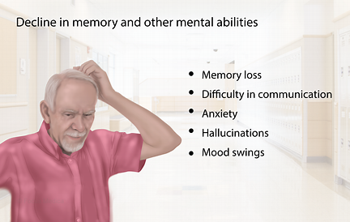
Alzheimer’s/Dementia

Slide 17
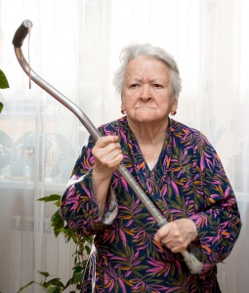
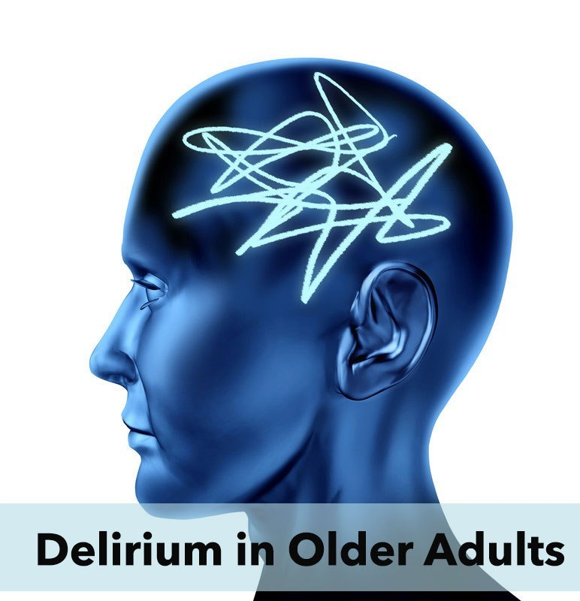
Challenging/Combativeness Behavior
What Causes Combative or Challenging Behavior?

Slide 18
Causes of Challenging/Combative Behavior
“The most common trigger is the provision of care. Because of memory loss and confusion, people with dementia might not understand why you're trying to help them, and begin to display challenging behaviors.”
Other Triggers:
Physical Discomfort
Poor Communication
Environmental Factors

Slide 19
Positive Approach to Care (PAC)
Teepa Snow Tips
Learn more about each resident: Modify that Approach to suit the care they need. That’s when individuals really SHINE! (regardless of where they are in their disease process)
Environment and how important it is to communication and care.
Environment can sometimes be one of those elements that seems to be overlooked as a factor in care and quality of life. We can pay more attention to other elements and fail to see the opportunities that are front and center in the environment that we are creating for the PLwD.
Think about the following questions related to Environment:
Are we upholding the four Fs?
For the PLwD (not for us), is the environment Friendly and Familiar?
Do people know details about the PLwD? Do the people in the environment greet me (as the PLwD) with warmth, familiar dialog, comfortable approach?
Are there familiar items in my environment that put me at ease? Things I know and remember? Are things available in my environment to manipulate and use? (purposeful living)
Are the surroundings we have created (including the people in it) Forgiving?
Does the environment support the freedom to make mistakes and not be “perfect”?
Is the environment Functional?
Does the environment meet the needs of those living there – or is more tailored to the ease and convenience of those working there?

Slide 20
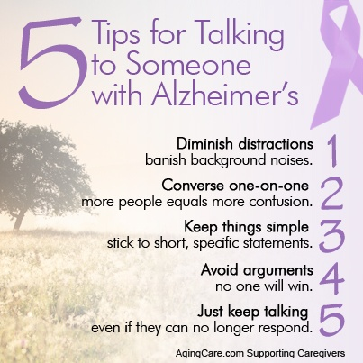
HELPFUL TIPS

Slide 21
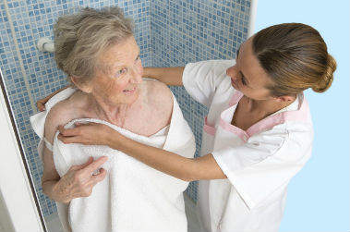
SCENARIO
Shower time: Resident is approached by someone he/she doesn’t know. Caregiver pulls at resident’s arm and says it’s time to shower and starts to remove clothing. Resident becomes agitated and combative.
Tips:
Caregivers should take their time and remain calm.
Communicate before approaching, explain in short sentences, establish a rapport and trust.
Don’t argue. Offer something familiar for them to hold.

Slide 22


Wandering and Exit Seeking Behavior
Who is at risk for wandering or exit seeking?
The Alzheimer’s Association says “anyone who has memory problems and is able to walk is at risk for wandering. Even in the early stages of dementia, a person can become disoriented or confused for a period of time”.

Slide 23

Tips for Wandering from the
Alzheimer’s Associations
Carry out daily activities. Having a routine can provide structure.
Identify the most likely times of day that wandering may occur. Plan programming during this time. Activities and exercise can reduce anxiety, agitation and restlessness.
Reassure the person if he or she feels lost, abandoned or disoriented. If the person with dementia wants to leave to "go home" or "go to work," use communication focused on exploration and validation. Refrain from correcting the person. For example, "We are staying here tonight. We are safe and I'll be with you. We can go home in the morning after a good night's rest."
Ensure all basic needs are met. Has the person gone to the bathroom? Is he or she thirsty or hungry?

Slide 24

RETENTION
Even when you have the right caregivers, keeping them satisfied and motivated can be challenging.
Notes:
This is referred to as satisfaction management, and it involves several efforts focused on truly understanding your caregivers and creating an environment where they feel like they’re thriving.

Slide 25
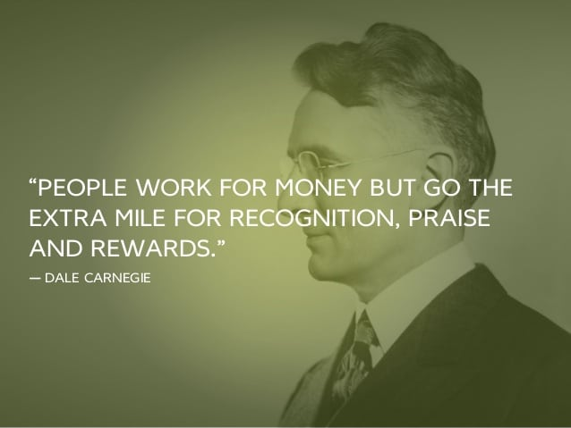
Ways to Motivate
Recognition
Reward

Slide 26


Ways to Motivate Cont’
Competitive Wages
Gift Cards
Certificates
Employee of the Month/Year Incentive
Thank You Card/Email
Providing Continuing Education
Tuition Reimbursement

Slide 27
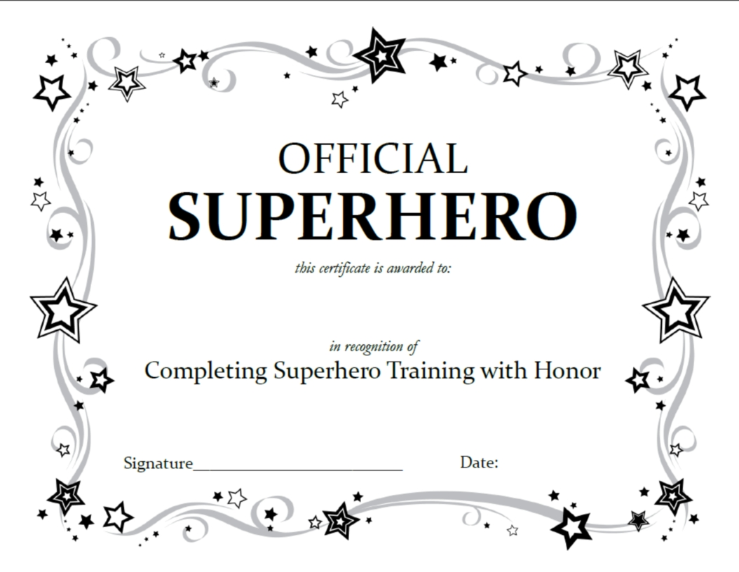
Caregiver Training Certificate

Slide 28

10 WAYS TO MOTIVATE EMPLOYEES
https://www.youtube.com/watch?v=_GiuysFb-iY

Slide 29

MOTIVATION+APPRECIATION=
HAPPY CAREGIVERS

Slide 30
Caregiver Testimony
Caregiver: Employee for 3 ½ years.
Question: What brought you to Memory Care? Answer: “It takes a special person to Alzheimer’s care. It takes patience and I have that.”
Question: When a resident becomes agitated when performing ADLs or wanders, what do you do? Answer: “Approach means everything”! I redirect, talk calmly, walk away if agitated and come back later”.
Question: When a resident declines or die, how do you cope with the stress? Answer: “The training provided helps a lot, we have training sessions on ways to cope”.
Question: What keeps you here? Answer: “I have great managers, and we have a great team”.
Question: What makes your managers great, what makes your team great? Answer: “My ED is fabulous, she is caring and understanding. She recognizes us by doing little things but means a lot. Lunches, snacks, parties, are always enjoyed. The nurse is caring and puts a lot in providing the proper training to all of us. Our team work together to get things accomplished”.

Slide 31
Executive Director Testimony
Executive Director/Administrator: Employee 4 ½ years
Question: How long have you been an Administrator for Assisted Living? Answer: “15 plus years”.
Question: You have the best turnover rate for caregivers in your area, what’s your secret? Answer: “I put myself in their shoes, lead by example”. “I also took CNA courses to learn the role of a caregiver and the skills, so I actually get on the floor and help out”.
Question: Are there any tips or advice that you would like to give to new managers or anyone that is struggling with caregiver turnover? Answer: “Never think your above any of your caregivers. Try to ensure they have a work-life balance, remember their birthdays, give small tokens of appreciation, have an employee of the month program, get on the floor”.
Hire enough staff to decrease overtime and caregiver burnout. Always have PRN staff in the event your Full-time and Part-time staff call in.

Slide 32

Questions

Slide 33
References:
https://www.alz.org/help-support/caregiving/stages-behaviors/agression-anger
https://www.crisisprevention.com/Blog/June-2017/Dementia-Training-for-CNAs-Memory-Care-Can-t-Happ
https://www.homecarepulse.com/articles/how-to-successfully-recruit-and-retain-caregivers/
https://hhs.texas.gov/doing-business-hhs/provider-portals/long-term-care-providers/nursing-facilities/quality-monitoring-program/evidence-based-best-practices/alzheimers-disease-dementia-care
https://teepasnow.com/resources/about-dementia/
https://www.verywellhealth.com/how-to-respond-to-combative-behavior-from-dementia-97987

