Slide 1
Passionate activity
Meaningful With A Purpose
May The Activities Force Be With You!
This Photo by Unknown Author is licensed under CC BY-NC

Slide 2
Introduction
Welcome everyone to your activity
Make sure people know one another
Arrive early!

Slide 3
How to Successfully Engage
Smile
Enthusiasm
Laughter
Encouragement
Purpose
Meaningful
Music
Always thank everyone for attending

Slide 4
Know Your Residents
Get to know your residents background, hobbies and life stories
Playing games with residents, one gets to know so much about their life
Become their friend, build trust and respect their needs
Share stories
Ask their advice
Give Compliments
Daily Hugs are important – know your audience!

Slide 5
Feeling Alone
Not all residents are social butterflies
Encouragement to partake in activities
Respect their privacy

Slide 6
Game Time! Example: music related, exercise, prop able, scene from a movie or TV!
Join together with a group of 4 people – (who you do not know)
Get to know each other in 10 minutes
Plan an activity in 10 minutes
As a group show us your amazing activity with your new friends

Slide 7
What makes An activity A Passionate Activity
Every assisted living has activities, but you want to make each one special. A passionate activity means avoiding the routine and putting the extra thoughtfulness and care in to every activity. Making it meaningful and with a purpose

Slide 8
Passionate Activity
An Adventure on the bus
lunch
Museum
Bowling
Shopping
Aquarium
Zoo
Take photos, pick up printed photos on way back to community. When returning home hand out photos! Surprise….

Slide 9
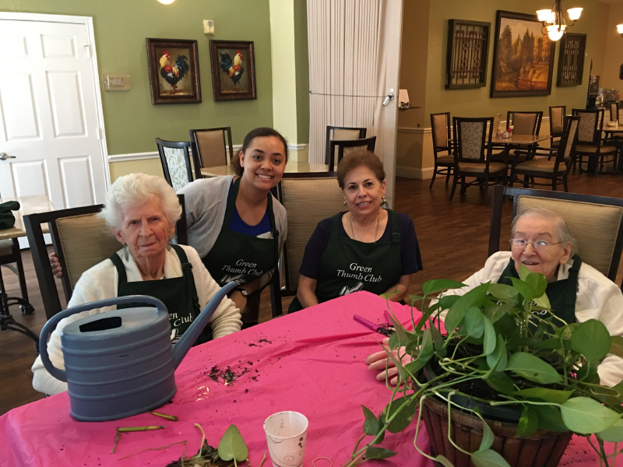
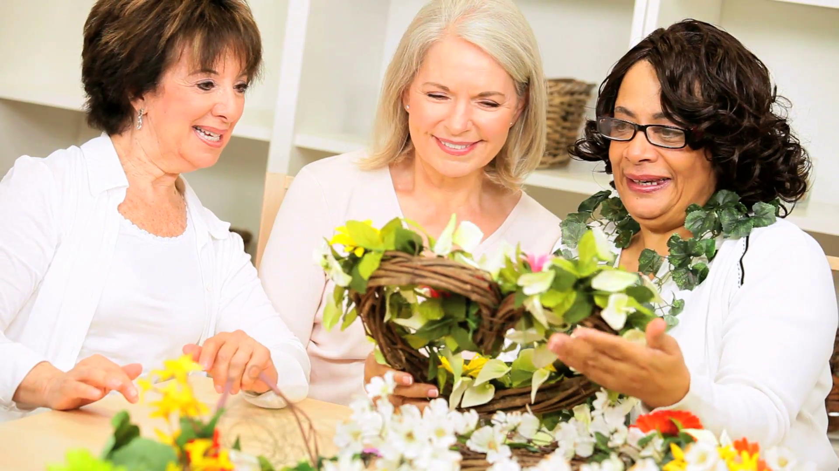
Passionate Activity
Gardening Clubs
Aprons
Flower Arranging
Usually all women – encourage ladies to talk about their flowers at their wedding
Favorite Flowers
Favorite Smells
Childhood Gardens
Encourage everyone to help take vases to each table

Slide 10
Passionate Activity Art Throbs Club
Invite everyone
Be prepared – all supplies, paper, and paints ready
Encourage & help
Take photos, share with family, print for resident
Show artwork in the activity room for a month
Organize an Art Show
Create big pieces as a group – hold a silent auction, proceeds going to Alzheimer’s research

Slide 11
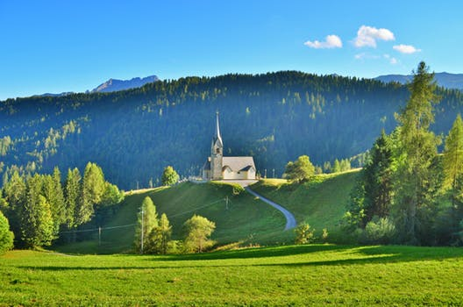
Passionate Activity
Church
Invite your residents
Music
Fellowship
Coffee and cookies after service
Encourage family members & children to join

Slide 12
Passionate Activity
Sewing Club
Purpose – blankets for the Humane Society
Outreach – take blankets to local dog shelter with the residents
Passion – leave a handwritten card with each blanket
Community Spirit – invite people to your community

Slide 13
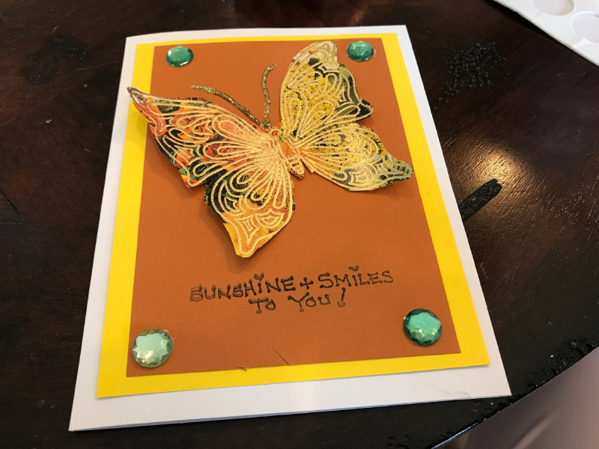
Passionate Activity
Arts & Crafts
Creative Card Club
Design hand written cards
Birthdays, anniversaries, get well, thank you,
Together with the residents take the Get Well card to hospital, rehab stays
Thank you cards for employees & volunteers
Welcome home, welcome to your new home!
Christmas card contest! Use a card to make as your official Holiday Card

Slide 14
New & Fresh Programs
Add New Activities
Poll Residents
New Resident Interests
Take off Activities with Low Attendance

Slide 15
Thank You & May The Activities Force Be With You!!

