Slide 1

Advocacy Update
Jaime Capelo, Capelo Law Firm
Diana Martinez, Texas Assisted Living Association
April 18, 2018

Slide 2

Out and About with TALA
TALA is committed to raising awareness of assisted living issues, especially at the Texas Capitol and at the Health and Human Services Commission – the agency that regulates assisted living in Texas.

Slide 3
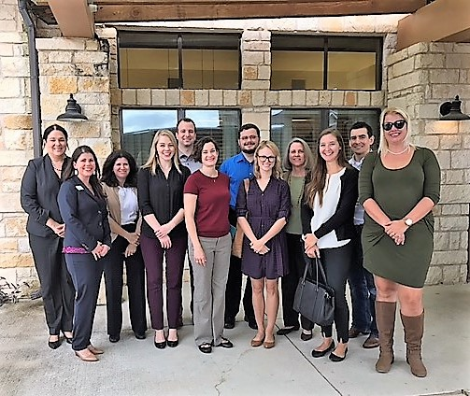
TALA
A Strong Voice for Assisted Living
October 4, 2017
TALA took 10 Health Policy staff on an legislative outing to two communities in the Austin.
A special thanks to Civitas’
Ledgestone Senior Living Community!

Slide 4
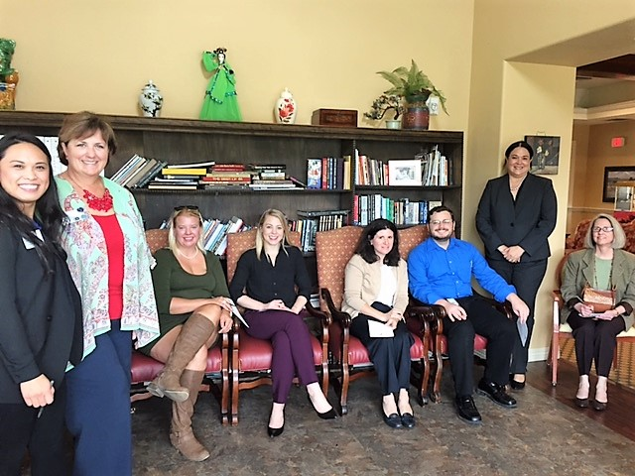
TALA
A Strong Voice for Assisted Living
As part of TALA’s Legislative outing, legislative staff participated in a Virtual Dementia Tour.
    A special thanks to Silverado Onion Creek | Memory Care Community!

Slide 5
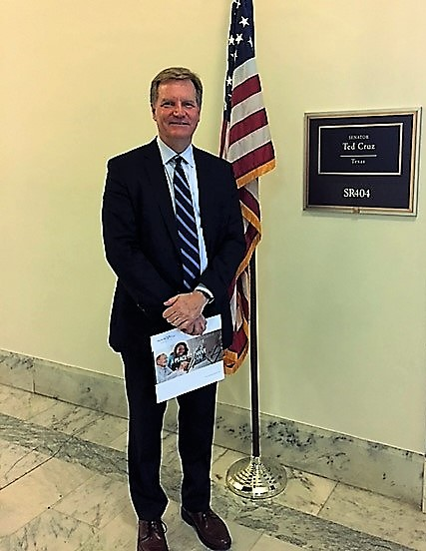
TALA
A Strong Voice for Assisted Living
TALA traveled to Washington DC to
participated in the Argentum Policy
Institute and Fly-in.
A Special thanks to Bernard Wheeler-Medley of Belmont Village!
September 13, 2017

Slide 6
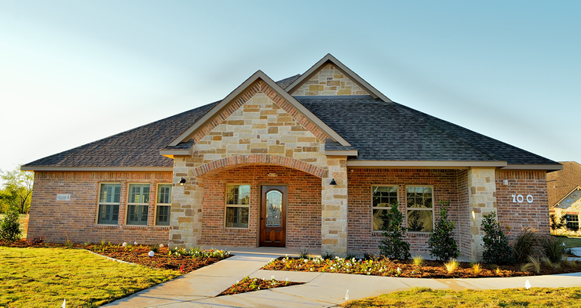
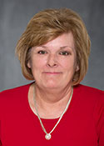
TALA
A Strong Voice for Assisted Living
October 25, 2017
A special thanks to Mustang Creek Estates in Burleson for hosting a tour for Representative Stephanie Klick!

Slide 7
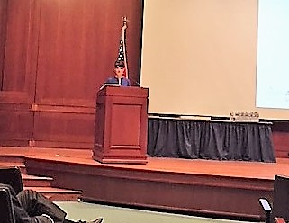
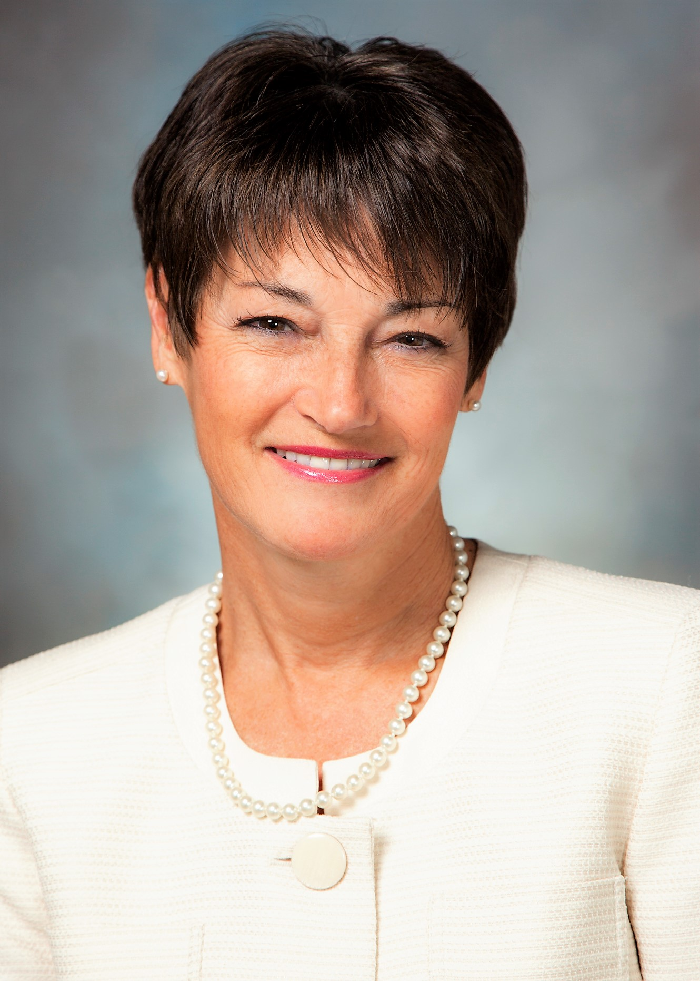
TALA
A Strong Voice for Assisted Living
Aging in Texas Policy Summit cohosted by TALA at the Texas Capitol on February 6, 2018.
Senator Donna Campbell - Keynote Speaker

Slide 8
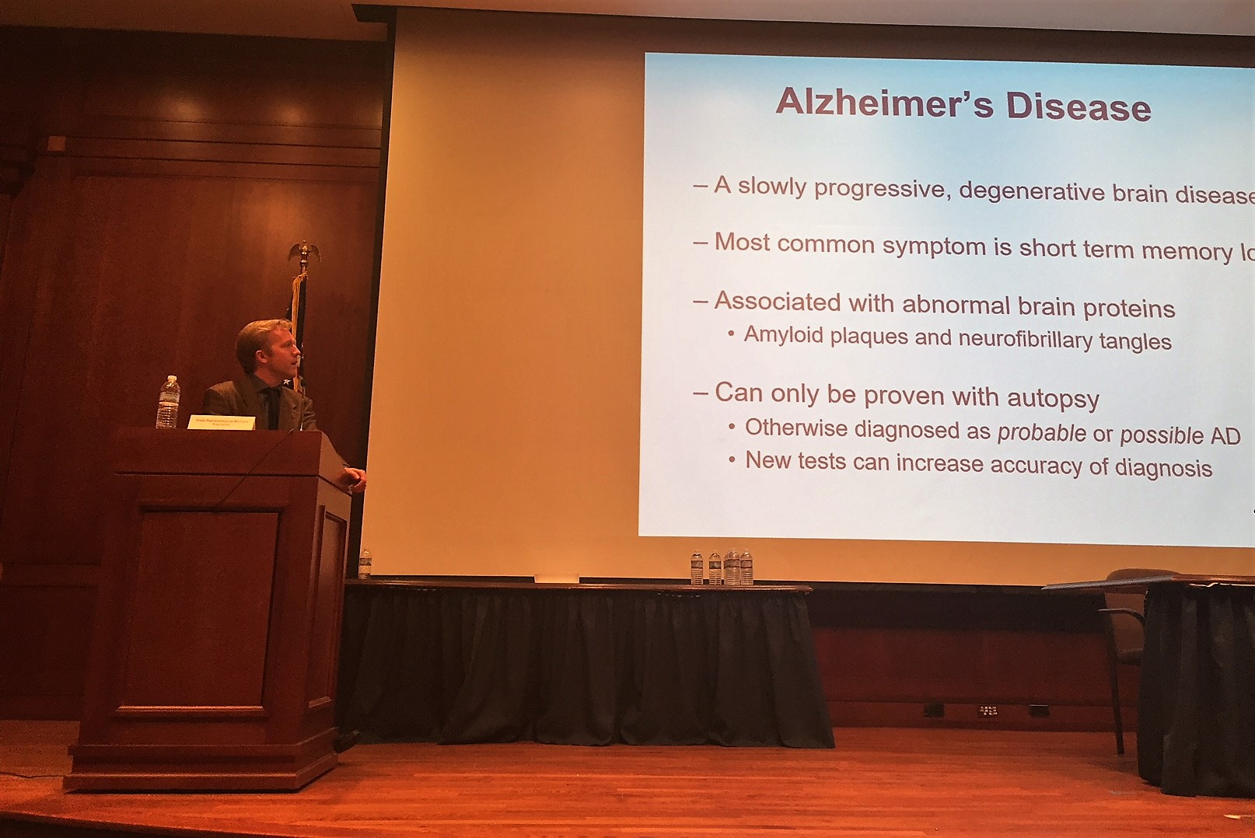

TALA
A Strong Voice for Assisted Living
Dr. John Bertelson, Chief of Neurology at Seton Brain & Spine Institute, spoke about the aging mind at the summit.

Slide 9
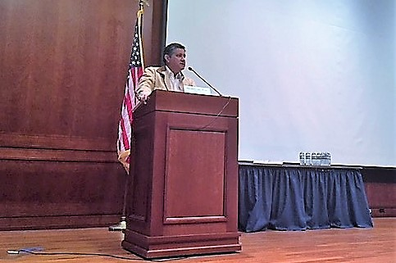
TALA
A Strong Voice for Assisted Living
  Representative Richard Raymond
  moderated a panel on managed care.
Panel members included representatives
from the Health and Human Services
Commission, AARP, the
Center for Public Policy Priorities,
Texas Public Policy Foundation and the
Texas Association of Health Plans.
Aging in Texas Policy Summit
February 6, 2018

Slide 10
TALA’s Legislators of the Year

Slide 11

of the Year
TALA looks for a legislator committed to:
Respecting the dignity of our elderly residents;
Willing to meet with TALA representatives, our membership, and residents; and
Working with TALA on legislation that impacts the assisted living industry and our residents.

Slide 12
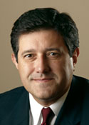

Legislator of the Year
Representative Richard Raymond
State Representative for House District 42
Hometown: Laredo
Chairman: House Human Services Committee
Heroic Action: Assisted with numerous TALA initiatives

Slide 13
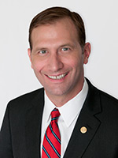

Legislator of the Year
Senator Charles Schwertner
State Senator for Senate District 5
Hometown: Georgetown
Chairman: Senate Health and Human Services Committee
Heroic Action: Assisted with numerous TALA initiatives

Slide 14
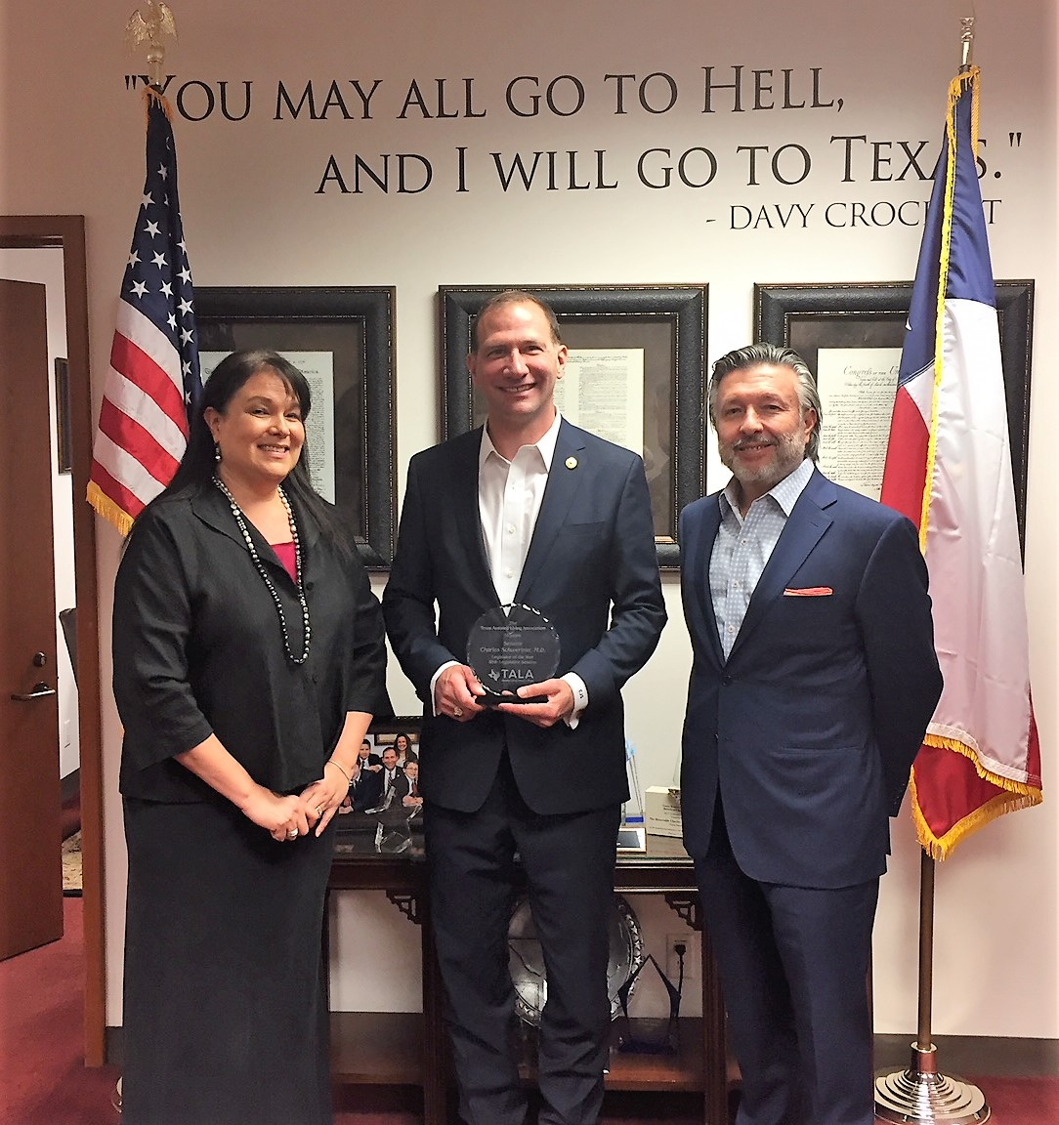
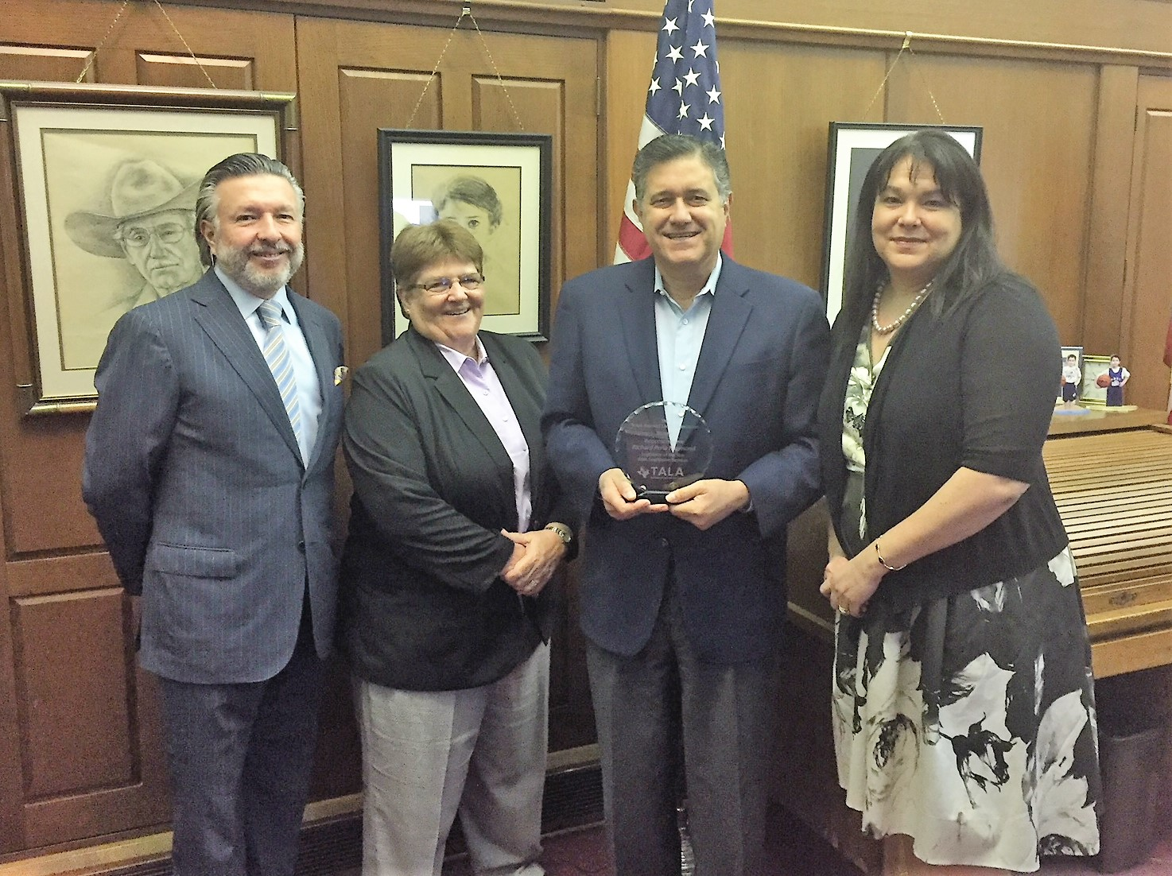
TALA’s Legislators of the Year
Senator
Charles Schwertner, MD
Representative
Richard Raymond

Slide 15

Regulatory Changes
New Regulations
What’s on the Horizon

Slide 16
New Regulations
By Pass to 3-Person Requirement
Good standing Licensure Title 40, Texas Administration Code (TAC), Chapter 92, Licensing Standards for Assisted Living Facilities - Handbook, Subchapter B, Sec. 92.21 and 92.22
Applicants who want to seek licensure through the “good standing” process need to fill out Form 3720-G for Assisted Living Facility Type A or B and Form 3721-G for an Alzheimer Certified Unit.
A facility that qualifies can get licensed right after their Life Safety Inspection.
TALA members have started using this process. Please let Diana Martinez know if you experience any issues.

Slide 17
New Regulations
By Pass to 3-person Requirement
Good Standing
    Operated or controlling person of a licensed Type A B in Texas for at least 6 years.
    Each facility operated by the applicant has not had a violation of a licensing rule that:
        resulted in actual harm to a resident, which is defined as a negative outcome that compromises the resident’s physical, mental or emotional well-being; or
        posed an immediate threat of harm causing or likely to cause serious injury, impairment, or death to a resident; and
      That the facility did not challenge; was affirmed; or is pending a final determination; and
    Has not had a sanction imposed by DADS against the facility during the six years before the date an application is submitted that resulted in a civil penalty; an administrative penalty; an injunction; the denial, suspension, or revocation of a license; or an emergency closure.
    Alzheimer Certified Facility – can not had more than 2 resident right violations in preceding 6 yrs.

Slide 18
New Regulations
Requirement for Memory Care
TAC, Title 40, Part 1, Chapter 92, Licensing Standards for Assisted Living Facilities - Handbook, Subchapter C, Sec. 92.51
Certification for Persons with Alzheimer’s Disease and Related Disorders
Must observe care of at least one resident who has been admitted to the Alzheimer’s facility or unit.
Valid for 2 years
HHSC cancels if there is a change of Ownership or HHSC determines facility or unit is not in compliance.

Slide 19
New Regulation
Lap Belts for Those is Wheelchairs
TAC, Title 40, Chapter 92, Licensing Standards for Assisted Living Facilities - Handbook, Subchapter G, Section 92.128
Requires a wheelchair self-release seat belt on a resident’s wheelchair if:
a signed authorization is received by the resident or guardian;
the resident consistently demonstrates ability to self-release and re-fasten; and
it complies with the plan of care.
A facility that advertises as a restraint-free facility is not required to comply with the request if:
  the facility provides current and prospective residents a written disclosure stating the facility is restraint-free and is not required to comply with such a request; and
  it makes reasonable efforts to accommodate the concerns of a resident who requested a lap belt.

Slide 20
New Regulations
Long-term Care Ombudsman
92.2, Definitions - Adds new definitions for Certified ombudsman, CFR, Managing local ombudsman, Ombudsman intern, Ombudsman Program, Private and unimpeded access, State Ombudsman, and Willfully interfere. Revises the definitions of Alzheimer’s Assisted Living Disclosure Statement form.
92.125, Residents Bill of Rights - Updates terms related to the Ombudsman Program.
92.127, Required Postings - Updates terms and provides a telephone number for the Ombudsman Program.
92.551, Administrative Penalties - Updates terms related to the Ombudsman Program. Adds that HHSC may assess an administrative penalty against a person who retaliates against a representative of HHSC. Adds that HHSC may assess an administrative penalty against a person who willfully interferes with or retaliates against a the State Ombudsman, certified ombudsman or an ombudsman intern performing their duties.

Slide 21
New Regulations
Long-term Care Ombudsman
92.801, Access to Residents and Records by the State Long-Term Care Ombudsman Program
  Outlines the assisted living facility requirements to allow access to a facility and a resident by the State Ombudsman, certified ombudsman and an ombudsman intern during regular visiting hours and for the State Ombudsman and a certified ombudsman at a time other than regular business hours to complete an investigation.
  Sets forth the conditions that must be met to allow the State Ombudsman or a certified ombudsman access to all files, records and other information concerning an incident, as well as the administrative records, policies and documents available to the residents and general public.
  Adds requirements related to the release of HIPPA information to the State Ombudsman or a certified ombudsman.

Slide 22

Health and Human Services Commission Reorganization
    DADS ceased to exist on 9/1/17
    Long-Term Care Ombudsman is now under the HHSC Chief of Staff
    Adult Protective Services remained at DFPS
    All regulatory services across the agency have be consolidated into the Regulatory Services Division – headed by David Kostroun, Deputy Executive Commissioner
    Assisted Living is under the Long-term Care Regulatory – headed by Mary Henderson, Associate Commissioner
    Website is still a work in progress
    Old emails continue to work - new email @HHSC.texas.gov

Slide 23
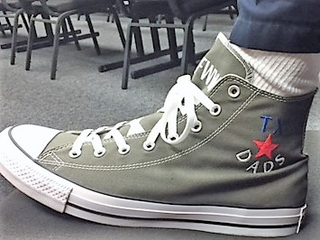
Fred Worley
Head of the Architectural Unit at DADS
Retires

Slide 24

On the Horizon for HHSC
  Expect delays on surveys and inspections - Last legislative session, HHSC sustained a cut in funding that resulted in a loss of 74 survey positions.
Expanding a pilot to all regions that will streamline the reports surveyors must write after conducting an ALF investigation. The new template puts a lot of the required information into a readable, check-box format, which will greatly reduce the amount of information that must be written out in a narrative style.
Another initiative they are developing is moving toward a more risk-based approach for surveys for ALFs. This means that HHSC would be able to conduct a scaled-back version of a survey for providers that have a strong regulatory history.

Slide 25
On the Horizon for HHSC
  Reorganization of Title 40, Chapter 92 – Will move to Title 26, Chapter 553
  Developing a new web-based portal that will allow LTC providers the ability to manage their license applications/renewals/changes online.
HHSC is developing a remediation plan to ensure Medicaid assisted living facility services are compliant with the federal HCBS regulation. HHSC is planning to share the strategy with stakeholders at the end of April. The remediation strategy will be included in the statewide transition plan we submit to CMS, which is planned for the end of the summer.
Resident Discharge – Recent policy discussion concerning Section 92.125 (a) (3) (X)

Slide 26
85th Legislative Session
TALA’s Legislative Agenda

Slide 27
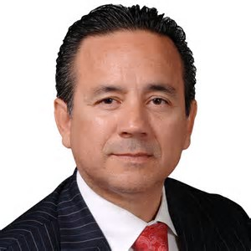
TALA Legislative Priority
Consistency and Predictability to Life Safety Code Inspections
SB 1049 - by Uresti / Klick
    Establishes technical memorandum to be issued at a minimum of twice/year.
        Interpretive guidance is be binding on surveyors
        Stakeholder meetings to raise issues to be addressed
        Any new requirements relating to an existing regulation will have to first appear in a technical memo
        Will be readily accessible on the HHSC website
Requires the adoption of 2012 or newer Life Safety Code (NFPA 101)

Slide 28
TALA Legislative Priority
Consistency and Predictability to Life Safety Code Inspections
SB 1049 Con’t
    Clarifies HHSC authority
      Local municipalities have enforcement and interpretation authority over local codes and regulations (IBC/IFC)
          HHSC cannot cite for a local code violation and must accept local authority’s interpretation of local codes/regs
      TDLR has authority over accessibility
          If TDLR has done an on-site inspection DADS cannot cite for accessibility
          If HHSC cites an accessibility tag prior to the TDLR inspection it must be rescinded if TDLR passes the facility

Slide 29
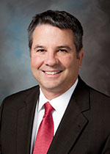

TALA Legislative Priority
A Balanced and Fair Informal Dispute Resolution Process
SB 924 by Perry / Klick
  Outsources IDR to an independent third-party
  Allows surveyor’s notes to be obtained
  Items containing information that reference a complainant or witness will have to be produced, however, confidential information such as witnesses name would be redacted
  Clearly indicates the burden of proof is on the State
  Gives ALFs extra time to submit rebuttal information

Slide 30
85th Legislative Session
Legislation Impacting Assisting Living

Slide 31
Legislation Impacting Assisted Living
HB 2025 by Davis – Requirements for ALZ Residents
Contains SB 932 by Schwertner – Omnibus Long-term Care Facilities Bill
Requirements for Facilities Treating Those with Alzheimer’s or Dementia
Facility must adopt, implement, and enforce a written policy that:
Requires an employee who provides direct care to a person with Alzheimer’s disease or a related disorder to successfully complete training; and
Ensures the care and services provided meet the specific identified needs of the person with a diagnosis.
Do not have the RTC if have more than one violation in a 2-year period.

Slide 32
Legislation Impacting Assisted Living
HB 2025 Con’t
Assisted Living Section from SB 932
Requires provider letters, informational letters, policy changes and policy clarification to be issued in a regular and streamlined fashion
Increases maximum penalty amount from $1000 to $5000 for serious violations
Removes right to correct for violations that cause actual harm of a repetitive or pervasive nature
Requires the creation a matrix of progressive sanctions based on scope/severity
Allows for an increases to licensing fees not to exceed $2500
Requires three-year licensure for ALFs
Requires surveys to occur at least every 2 years

Slide 33
Legislation Impacting Assisted Living
SB 1089 by Perry - Food Service Workers in Large Assisted Livings
  Clarifies that a food service worker trained in a course for employees of a single entity is considered to have meet a local health jurisdiction’s permitting requirements only as to food service performed for that entity.
  Establishes that a food service worker trained in a food handler training course that is accredited by American National Standards Institute or that is accredited by the department and listed on its registry is considered to have met local health jurisdiction's training, testing, and permitting requirements.
A local health jurisdiction may not charge a fee or require an additional local food handler card for those who take a ANSI or other accredited course.

Slide 34
Legislation Impacting Assisted Living
HB 284 by Springer - Wheelchair Lap Belts / Required if Requested
Requires ALs to place a wheelchair self-release seat belt on a resident’s wheelchair if:
a signed authorization is received by the resident or guardian;
the resident demonstrates ability to self-release and re-fasten; and
it complies with the plan of care.
A facility that advertises as a restraint-free facility is not required to comply with the request if:
  the facility provides current and prospective residents a written disclosure stating the facility is restraint-free and is not required to comply with such a request; and
  it makes all reasonable efforts to accommodate the concerns of a resident who requested a lap belt.

Slide 35
Legislation Impacting Assisted Living
HB 658 by Bernal – Early Voting Legislation
Repealed by SB 5 passed during the Special Session
A polling place must be established if 5 or more applications for early voting mail-in ballots, based on the grounds of age/disability, are received from residents of a residential care facility (Chap 242 and 247 facilities).
Requires that the mail-in ballot request be held until it is determined if 5 or more people are going to request.
Applies to ALFs with more than 10 beds.
The administrator of the facility must make space available in a common area for purposes of early voting and allow signs to be posted.
Administrator has input into when the early voting will occur.
Only those who reside at the facility can early vote there.

Slide 36
Legislation Impacting Assisted Living
HB 970 by Cortez
Requires a state plan for the prevention and treatment of diseases caused by Streptococcus pneumoniae.
The plan must specifically target persons living in LTC facilities and others at risk
The department must seek input into the plan’s development
The department must develop a program to heighten awareness
Must post prevention, treatment, and detection information on the department’s website

Slide 37
Legislation Impacting Assisted Living
HB 3564 by Klick - LTC Ombudsman
Allows LTC Ombudsman to visit all people in LTC, not just those 60+.
Establishes that the LTC Ombudsman’s office is to act independently in the performance of its powers and duties. However, HHSC has oversight.
Requires LTC facilities to cooperate with an investigation by the LTC ombudsman/representative.
Requires LTC Ombudsman to investigate any grievance against one of its representatives.
Clarifies that the lobbying prohibitions do not apply to the LTC Ombudsman to the extent necessary for it to perform its duties.

Slide 38
Legislation Impacting Assisted Living
HB 1642 by Bell
Requires HHSC only report substantiated abuse, neglect, or exploitation to the appropriate law enforcement agency.
HB 3934 by Bell
Allows the department to waive the requirement that surveyors have to observe operations of a LTC facility for 10 days if the surveyor has recently worked has had one-year of full-time employment in a Texas nursing facility as an administrator; RN, LVN, or social worker.

Slide 39
Legislation That Almost Impacted Assisted Living
SB 11 85 (1) by Perry/Bonnen
Procedures and Requirements for DNR Orders
Creates guidelines for DNR orders used in a health care facilities
DNR valid if
  Written directions of competent patient
  Oral directions of a competent patient
  Directions in an advance directive
  Directions of legal guardian or agent under a medical power of attorney
  Treatment decision made in accordance with Health and Safety Code Sec. 166.039.
  Attending physician believes death is imminent within 24hrs.
  Must be place in chart / medical record
  Facility must provide notice of the policy upon admission
  Must notify agent or family

Slide 40
When do the laws of the 85th take effect?
Almost all laws passed during the 85th took effect on 9/1/2017.
However, most of the laws that impact ALCs have to have changes made to the Texas Administration Code.
That process takes time. First, the agency has to develop the new regulations and present them to the HHSC Executive Council. Then the suggested change is posted to the Texas Registry for public comment. The change is finally signed off on by the HHSC commissioner.
Expect regulation changes to start happening in early spring.
TALA will monitor implementation of significant legislation from the 85th – We will participate in various work groups to provide input, submit testimony, and testify as needed.

Slide 41
85th Legislative Session
Legislation Impacting Assisting Living That Failed to Pass

Slide 42
Legislation Impacting Assisted Living That Failed to Pass
HB 577 by Paul Workman
Check the Box / Local Ordinance Prohibition
Prohibits local ordinances that would prohibit or limit a private employer’s ability to request, consider, or take employment action based on criminal history of applicant or employee.

Slide 43
Legislation Impacting Assisted Living
That Failed to Pass
HB 942 by Donna Howard
Sexually Transmitted Disease Study Among the Elderly
Would require a study on STD prevalence and incidence among elderly in state, including those residing in SNF and ALF.
Would also require recommendations on reducing risk of contracting.

Slide 44
Legislation Impacting Assisted Living
That Failed to Pass
HB 1120 by Drew Springer
Certificates of Occupancy for Buildings Required to Meet Accessibility Standards
Would prohibit a municipality from issuing a final certificate of occupancy unless the building had passed an accessibility inspection.

Slide 45
Legislation Impacting Assisted Living
That Failed to Pass
HB 3469 by Yvonne Davis
Requiring AL Licensing for 1 to 3
Would require those with 1 to 3 residents to register as AL if at least one had Alzheimer’s or dementia.
  Would have regulations specific to this class of ALs.
  Would prohibit from having both an Alzheimer/dementia resident and one with severe mental illness.
  Would have staffing requirements to employ at least one person who has training and experience caring for those with Alzheimer’s or dementia.
Would require those with 1 to 3 and providing AL services to register with the Commission as a Group Home Facility.

Slide 46
Legislation Impacting Assisted Living
That Failed to Pass
HB 3533 by Richard Raymond
Inspection Procedures for Assisted Living Communities and a creation of a LTC Oversight Committee
A municipal fire marshal could grant a waiver for a violation of the life safety code cited by DADS.
Would require all surveyors to be a licensed health care professional.
Would establish a Long-Term Care Legislative Oversight Committee
  Would review proposed Commission rules.
  Would review any proposed legislation by Commission or AG pertaining to LTC facilities.
  Could hear operational disputes from facilities
  Would submit a report to legislature every 2-years.

Slide 47
Legislation Impacting Assisted Living That Failed to Pass
HB 3711 by J.D. Sheffield – Communicable Disease Response Plan
All ALs would have to develop a plan for preventing and responding to outbreaks of communicable disease, including influenza.
Would have established regional advisory committees to monitor antimicrobial stewardship in LTC facilities.
ALs would have to provide educational materials to facility employees about immunizations.
HB 3888 by John Zerwas – Restrictive Covenants
Would have Clarified that POAs can enforce restrictive covenants against assisted living communities.

Slide 48

What’s next?
Flying towards the 86th Legislative Session

Slide 49
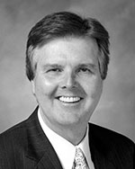
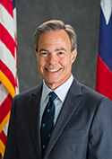
Interim Charges
Members of the legislature submit ideas for interim charges to Lt. Gov. Patrick and Speaker Straus.
Interim charges are given to legislative committees by the head of their respective legislative body to direct the work and research that committees will do in preparation for the next session.
The committees hold hearings on the interim charge issues and submit a report of their findings prior to next session.
Much of the legislation that will be filed next session comes from information obtained during the interim by the various committees.

Slide 50
Interim Charges
Senate Health and Human Services Committee
Monitoring Charge: Monitor the implementation of legislation addressed by the Senate Committee on Health and Human Services, 85th Legislature and make recommendations for any legislation needed to improve, enhance, and/or complete implementation, including but not limited to:
Initiatives to strengthen oversight of long-term care facilities to ensure safety and improve quality for residents and clients of these entities.

Slide 51
Interim Charges
House of Representatives Human Services Committee
Study the impact of Hurricane Harvey and the response to the storm on individuals living in long-term care facilities, assisted living facilities, state supported living centers, licensed community group homes, and children in the foster care system. Identify and recommend necessary solutions to ensure appropriate disaster-related protocols are in place to keep vulnerable Texans protected. Also, identify any challenges state agencies experienced in responding to the storm or during recovery efforts.
Examine the survey process for nursing facilities to determine any duplication of government regulations. Consider recommendations to reduce duplication while ensuring patient safety is preserved.

Slide 52
Interim Charges
House of Representatives Public Health Committee
Study treatment of traumatic brain injury, Alzheimer's, and dementia, and recommend opportunities for advancing treatment and cures.

Slide 53
Preparing for the
86th Legislative Session
Interim charges – TALA is monitoring, testifying, and providing input.
Legislative issues – TALA will be working with legislators that filed legislation last session that didn’t pass.
    Restricting Local Ordinances / Workman
    Model Code Adoption / Timelines for CO issuance / Huffines
    Voting in LTC facilities / Oliverson
If you have ideas or issues that you would like TALA’s Public Policy Committee to examine please contact Diana Martinez.

Slide 54

Grass Roots Advocacy
Set a course to inform!
TALA is working to get members of the legislature and key staff out to assisted living communities.
Having people at the Capitol informed about assisted living issues gives us an edge during the legislative session.
If you are interested in inviting a legislator to your community please contact Diana Martinez.
Additionally, TALA will be conducting informational sessions prior to session for those who want to be more active in the process.

Slide 55

Contact Information
Diana Martinez
VP of Public Policy
Texas Assisted Living Association
4505 Spicewood Springs Rd, Suite 250
Austin, TX 78759
512-914-3908
Diana.martinez@tala.org

